Slide 1
Digital Thinking and Innovation
Innovation in Digital Trends

Slide 2

Introduction
This topic discusses how the traditional ways are pushed aside by the digital technologies, and the trends that are well accepted and continue to emerge

Slide 3
Learning Outcomes for the Lecture
At the end of this lecture you will be able to:
Explain how a business world is reshaped by digitization
Understand the role of the Internet in the business world
Explain the categories of digital trends

Slide 4
Content
Digitization of Businesses
Digital Trends:
Big Data, Cloud Computing and Mobile Internet
Software-Defined Anything
Outsourcing and Crowdsourcing
Prosumer Economy
Long Tail
Digital Finance
Collaboration

Slide 5
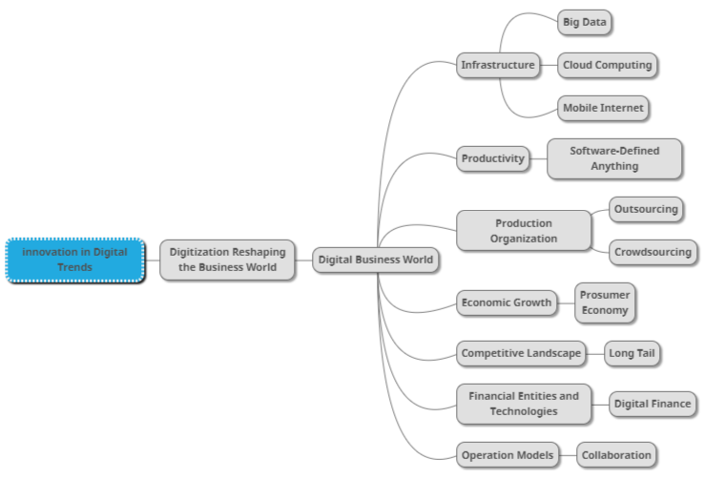
Mind Map

Slide 6
Learning Outcomes for the Lecture
At the end of this lecture you will be able to:
Explain how a business world is reshaped by digitization
Understand the role of the Internet in the business world
Explain the categories of digital trends

Slide 7
A Business World Reshaped by Digitization
As social media platforms have connected people from all over the world with each other, time and space are no longer barriers to communication
Telegram: 400 million users
Sina Weibo: 500 million users
WeChat: 500 million users
Facebook: 1.2 billion users
WhatsApp: 1.6 billion users

Slide 8
A Business World Reshaped by Digitization
With the rapid evolution of digital technologies, the flood of information sweeps all over the world at virtually no cost
Promotes closer links:
between humans
between things
between humans and things
Individuals, companies, industries and countries will be affected when the revolution on the horizon arrives.

Slide 9

Kodak: Missing Its Own Moments
Kodak (more than 130 years old giant) was the undisputed king of photographic film, with two thirds of global market share. Kodak created many “firsts”:
It came out on top in the imaging and photographic film market
It created the world’s first digital camera using a Charge Coupled Device (CCD), a major piece of technology for digital imaging
The first company to flame out in the imaging industry
It failed to capture its own moments:
To keep abreast of digital technologies

Slide 10
Kodak: Missing Its Own Moments
How do you take pictures today? Where do you store the photos?
Why do you think Kodak didn’t make it through?

Slide 11
Learning Outcomes for the Lecture
At the end of this lecture you will be able to:
Explain how a business world is reshaped by digitization
Understand the role of the Internet in the business world
Explain the categories of digital trends

Slide 12
The Ever-Changing Digital Business World
The leaders in the digital age can easily fall behind
Top 4 Tech giants Microsoft, Intel, HP, and Yahoo have been dethroned by Apple, Google, Amazon, and Facebook
Many companies have fallen because of a resistance to reform; or have undergone disruptive changes
Nokia and Blackberry ended up selling their assets
Market Players are inspired by the Internet

Slide 13
Case Study
How has education evolved due to the use of the Internet?

Slide 14
Learning Outcomes for the Lecture
At the end of this lecture you will be able to:
Explain how a business world is reshaped by digitization
Understand the role of the Internet in the business world
Explain the categories of digital trends

Slide 15
The Digital Trends
Big data, cloud computing, mobile internet - focuses on changes in infrastructure
Software-defined anything - focuses on changes in productivity
Outsourcing and crowdsourcing - focuses on changes in production organization
Prosumer economy - focuses on changes in forces of economic growth

Slide 16
The Digital Trends
Long tail - focuses on changes in competitive landscape
Digital finance - focuses on changes in financial entities and technologies
Collaboration - focuses on changes in operations models

Slide 17
The Digital Trends
Big data, cloud computing, mobile internet - focuses on changes in infrastructure
Software-defined anything - focuses on changes in productivity
Outsourcing and crowdsourcing - focuses on changes in production organization
Prosumer economy - focuses on changes in forces of economic growth

Slide 18
Big Data
Big data emphasizes not the amount of data but rather using new thinking to interpret the data, with the help of the Internet
Spotify, an on-demand music providing platform, uses Big Data Analytics, collects data from all its users around the globe, and then uses the analyzed data to give informed music recommendations and suggestions to every individual user.
Amazon Prime that offers, videos, music, and Kindle books in a one-stop shop is also big on using big data.

Slide 19
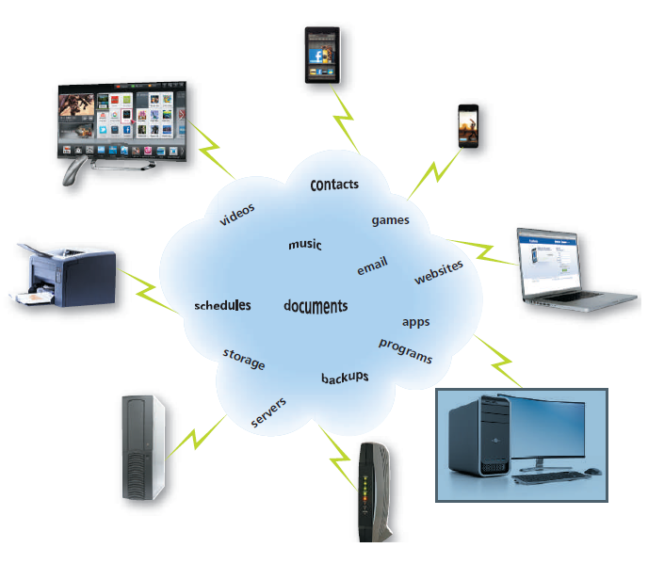
Cloud Computing
Cloud computing - an environment that provides resources and services accessed via the Internet
Computing over the Internet
Virtualized Computing Platform
Scalable use of computing resources
Pay-per-Use concept

Slide 20
Mobile Internet
If the PC has changed our work style and ways of production, then the mobile Internet is reshaping our lifestyle.
Jack Ma, President of Alibaba
When you get lost in an unfamiliar place, Waze on your mobile phone will guide you to your destination
Wherever you are, you can browse the news, read a novel, tweet, play games or watch movies on your mobile phone or tablet
When you need a taxi, you can use Grab app on your mobile phone to find a taxi nearby

Slide 21
The Digital Trends
Big data, cloud computing, mobile internet - focuses on changes in infrastructure
Software-defined anything - focuses on changes in productivity
Outsourcing and crowdsourcing - focuses on changes in production organization
Prosumer economy - focuses on changes in forces of economic growth

Slide 22
Software-Defined Anything
“Software-defined anything” is identified as one of the “Top 10 Strategic Technology Trends” as a technology with the potential for significant impact on enterprises
In an era where young entrepreneurs are keen on disruptive innovation, “software-defined anything” is not merely a concept but a growing trend towards disrupting traditional way of thinking
Examples include: Amazon, the world’s largest bookseller; Netflix, the largest video service by number of subscribers; Apple’s iTunes, one of today’s dominant music companies;

Slide 23
The Digital Trends
Big data, cloud computing, mobile internet - focuses on changes in infrastructure
Software-defined anything - focuses on changes in productivity
Outsourcing and crowdsourcing - focuses on changes in production organization
Prosumer economy - focuses on changes in forces of economic growth

Slide 24
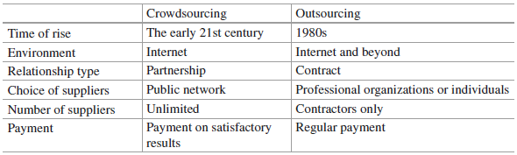
Outsourcing and Crowdsourcing
The idea behind outsourcing is “focus on what you do best and let others do the rest”
Crowdsourcing encourages consumers and users to take charge and pursue their goals
Table 1: The difference between Outsourcing and Crowdsourcing

Slide 25
Outsourcing and Crowdsourcing
Wreckage searching: When MH370 went missing, DigitalGlobe, an American satellite mapping company, set up Tomnod, a crowd-sourcing initiative, encouraging internet users to scan and tag images of more than 1200 mi2 of ocean to locate the missing plane
Mapping: User editors made hundreds of millions of map edits and updated Waze’s map to reflect the changes on the ground

Slide 26
Outsourcing and Crowdsourcing
Software testing: Applause (formerly uTest), an American venture-funded software and application testing company collaborates with more than 140,000 crowdtesters and debuggers, to remove all the possible bugs in the software applications
Knowledge: Wikipedia has over 4 million entries in English, and other standalone Wikis in 282 languages totaled up to 21 million entries, 32 million users and 1.2 billion edits. Wikipedia is ranked among the ten most popular websites on the Internet

Slide 27
The Digital Trends
Big data, cloud computing, mobile internet - focuses on changes in infrastructure
Software-defined anything - focuses on changes in productivity
Outsourcing and crowdsourcing - focuses on changes in production organization
Prosumer economy - focuses on changes in forces of economic growth

Slide 28
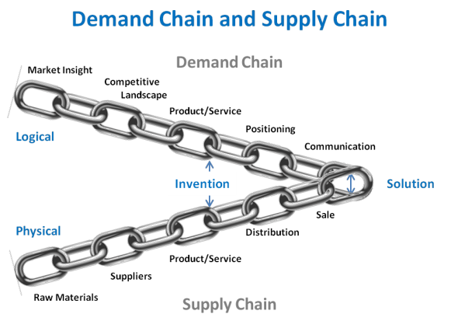
Prosumer Economy
Competition is getting fierce globally
Companies are under great pressure to offer more and better products and services at lower costs and higher speed
A game change: from Supply Chain to Prosumer Economy

Slide 29
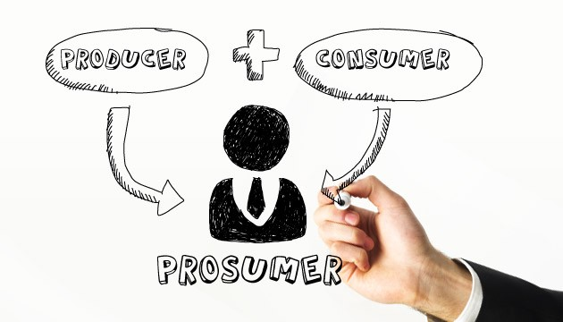
Prosumer Economy
Prosumer Economy: Consumer demand play a leading role reshaped into the demand chain
The term prosumer is a portmanteau of the words 'provider' and 'consumer‘
A prosumer is an individual who not only consumes but also produces

Slide 30
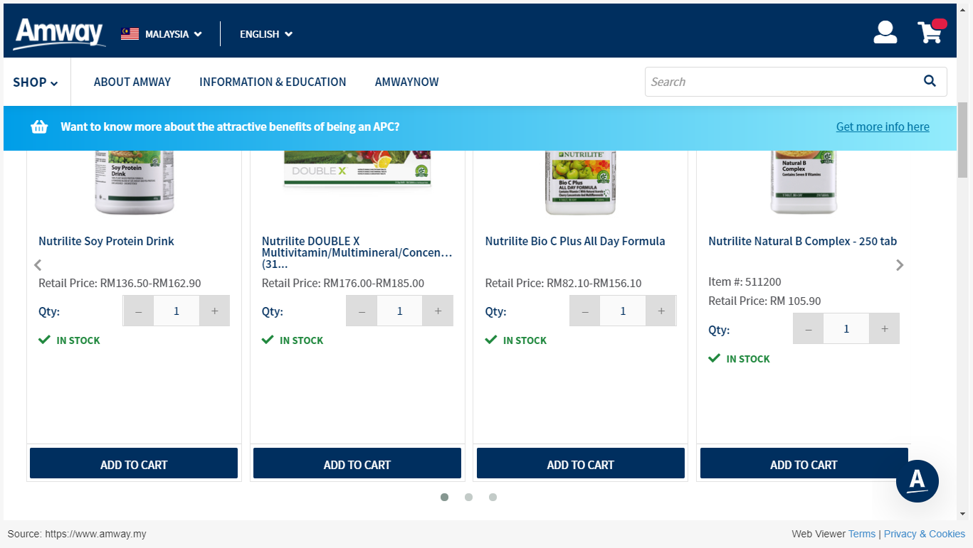

Slide 31
The Digital Trends
Long tail - focuses on changes in competitive landscape
Digital finance - focuses on changes in financial entities and technologies
Collaboration - focuses on changes in operations models

Slide 32
Long Tail
“We can summarize the secrets of creating a prosperous long tail market in two sentences: Provide the customers with all the products; Help me to find it.”
—Long Tail Theory
Companies focus more on achieving economies of scale
Average costs decrease with the increase of production
A company experiences diseconomies of scale if its profits decrease with expanded production

Slide 33
Long Tail and Economy of Scale
Refers to the large number of products that sell in small quantities, as contrasted with the small number of best-selling products
Companies achieve economies of scale by increasing production and lowering costs - costs are spread over a larger number of goods. Reduction in per unit cost of production when production volume increases e.g.
Fixed cost of $1000 needed to produce 10 units of Pencil A
Therefore, Cost = $100 per pencil
To produce 50 units of Pencil A, Cost = $20

Slide 34
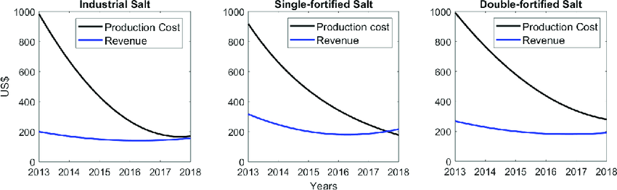

Slide 35
The Digital Trends
Long tail - focuses on changes in competitive landscape
Digital finance - focuses on changes in financial entities and technologies
Collaboration - focuses on changes in operations models

Slide 36
Digital Finance
In traditional payment models, customers can’t gain access to the settlement systems of all banks given the cost and efficiency restrictions
Third-party payment companies integrate the gateway interfaces and build a bridge between numerous merchants and banks
PayPal
Alipay
Google Wallet

Slide 37
The Digital Trends
Long tail - focuses on changes in competitive landscape
Digital finance - focuses on changes in financial entities and technologies
Collaboration - focuses on changes in operations models

Slide 38
Collaboration
Collaboration: When a group of people come together and contribute their expertise for the benefit of a shared objective, project, or mission.
A photographer working with a designer to create a cover image
A technology department regularly meet with the marketing team to plug away at quarterly goals

Slide 39
Collaboration
Collaboration Tools:
Google Drive
Google Meet
Skype
GoToMeeting
Microsoft Teams
One Drive
SharePoint
Yammer
Many, many more…

Slide 40


Group Discussion
Watch and discuss the content of the video:
https://www.youtube.com/watch?v=5sKb8IM7veA

Slide 41


Slide 42
Summary
Digitization of Businesses
Digital Trends Affecting the following areas:
Infrastructure
Productivity
Production Organization
Economic Growth
Competitive Landscape
Financial Entities and Technologies
Operation Models

Slide 43
Questions and Answer
Q & A

Slide 44

Next Lecture
Innovation through Artificial Intelligence

